Slide 1
Star Rush Python Game Project
Submitted to: Sir Warren Padua
Subject: ICS.6 (3:30 – 7:30) F
Members:
Nalibsan, Suzzane
Litilit, Emery
Fagyan, Zyra Yell
Peralta, francess anne

Slide 2
Background:
Our system is based on the Japan classic game called Sokoban from the late 80’s. "Sokoban" (in Japanese terms) means a "warehouse man". We’ve just added a twist on the graphics and rest of the gameplay are similar to the game Sokoban.
The rules of Sokoban are very simple: - Push one star at a time to goal squares - Push and Move while the character and every steps should be minimized.
We’ve also used Pygame to help us possibly and productively create the game.

Slide 3
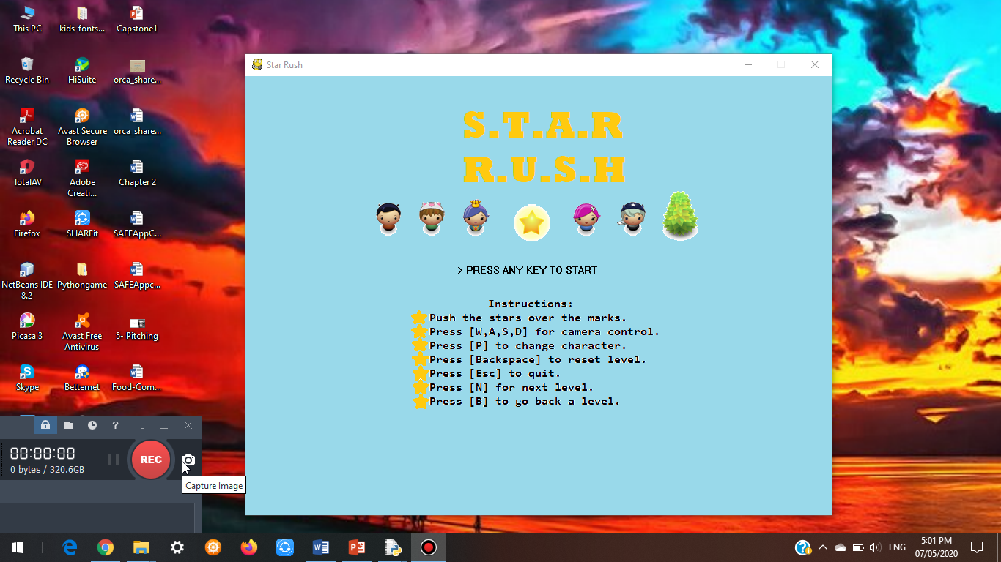
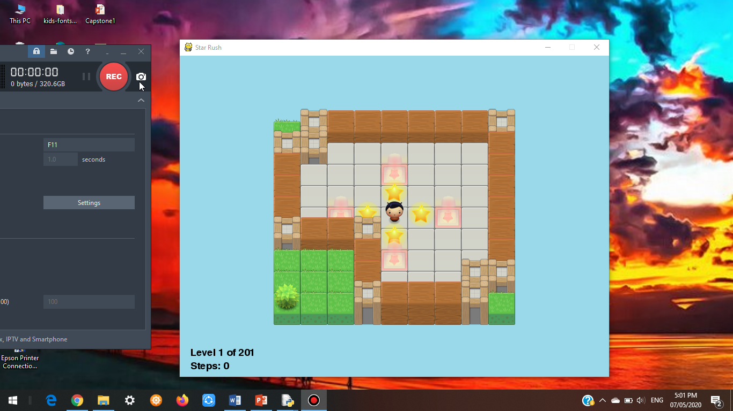
Gameplay System:
The home display shows off the instructions set for the players to understand its functions.
The goal is to move the character and push the stars to its destination (square) with a few number of steps as possible

Slide 4

Gameplay System:
Now that you’ve moved the character and pushed the star to its base it goes the same as others

Slide 5

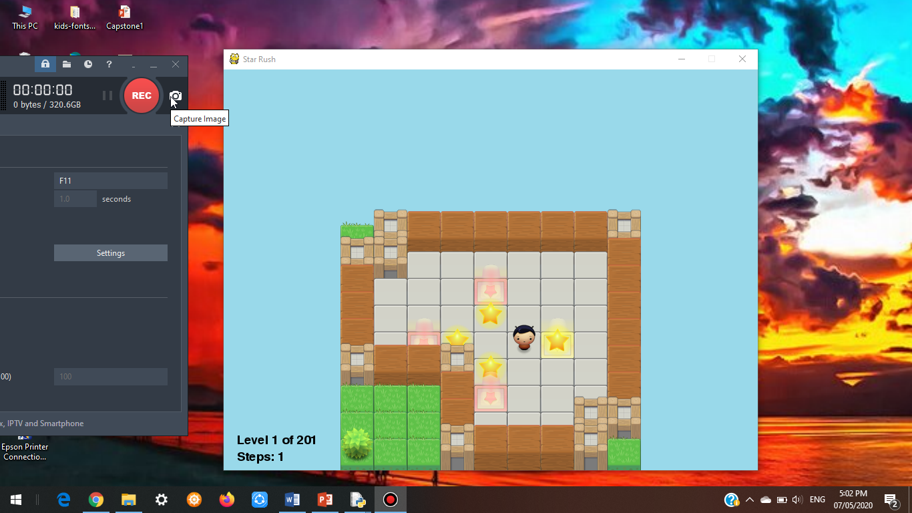



Gameplay System:
You can automatically change your game character while playing the game without hassle just by pressing “P”

Slide 6
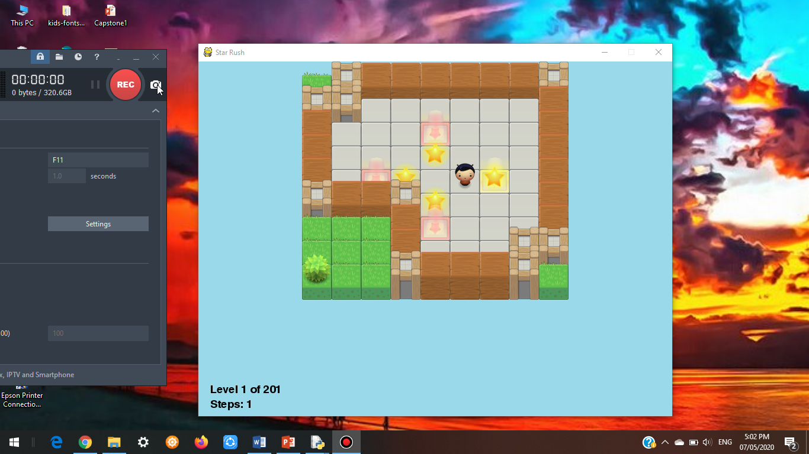
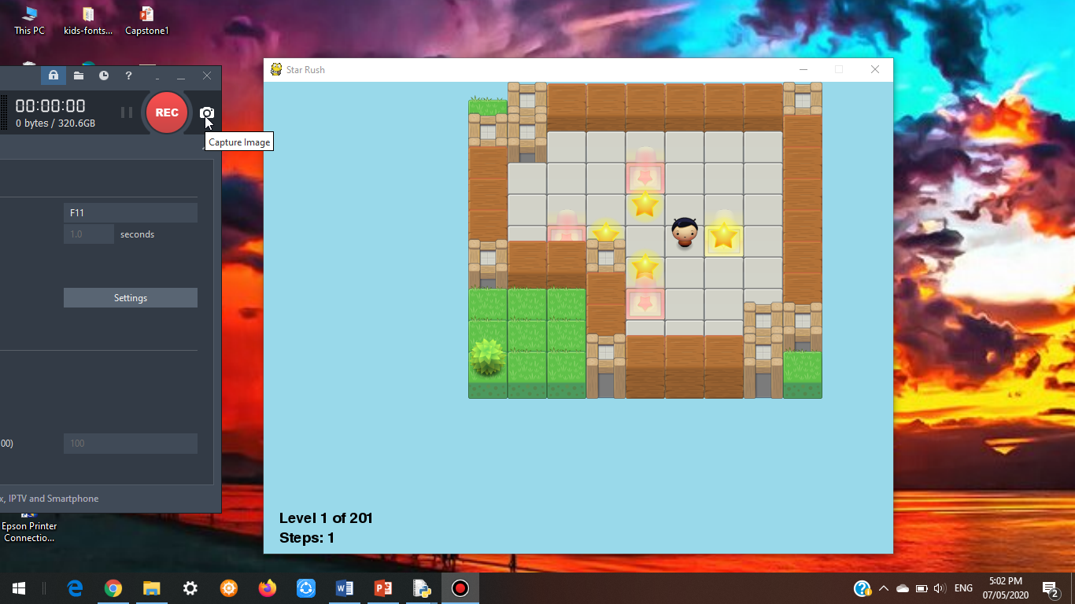
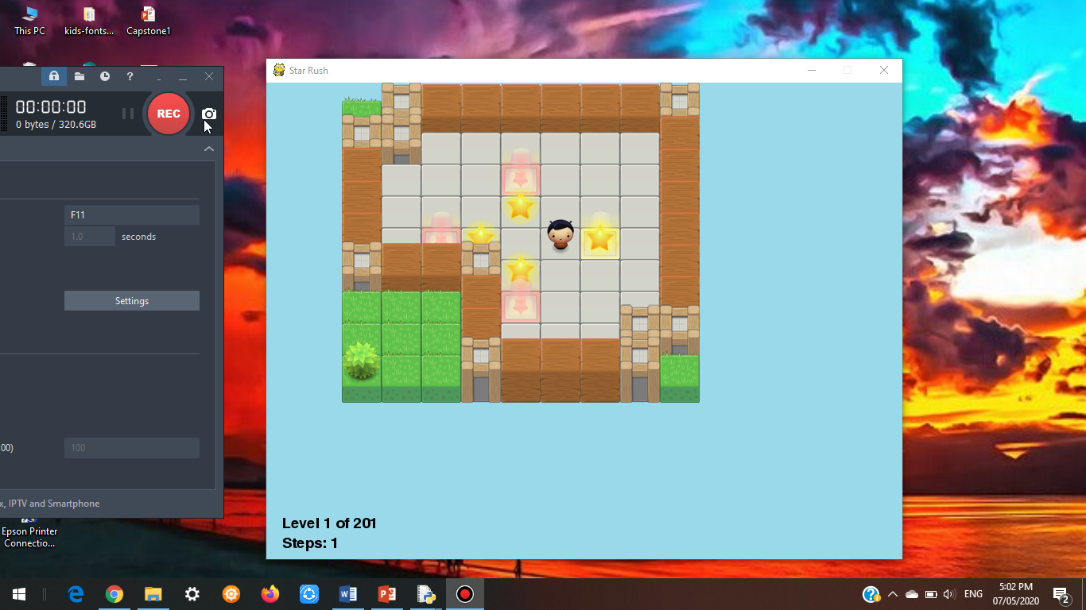
Gameplay System:
You can maneuver the camera of the map from left to right or up and down which will be handy to wider maps on different level just by pressing:
W(up)
A(left)
S(down)
D(right)

Slide 7
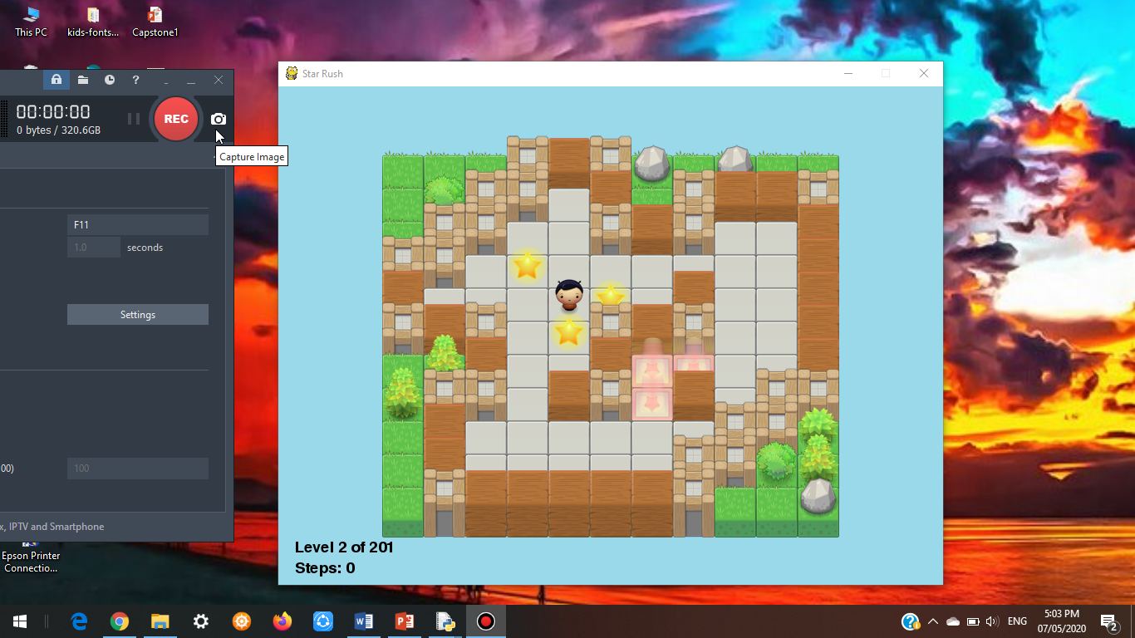
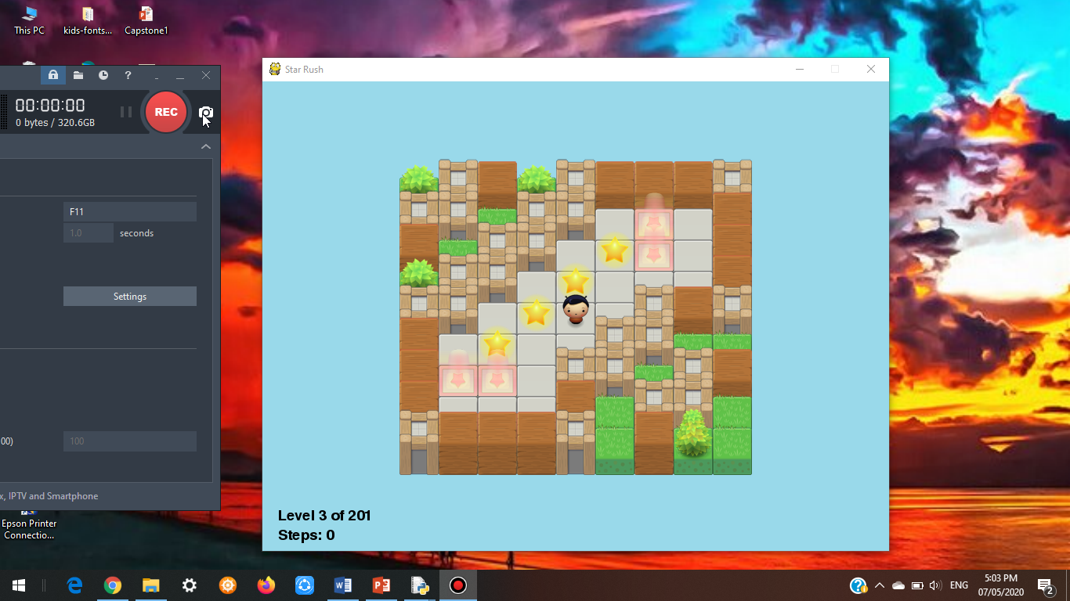
Gameplay System:
You can also skip to other levels by pressing “N”

Slide 8

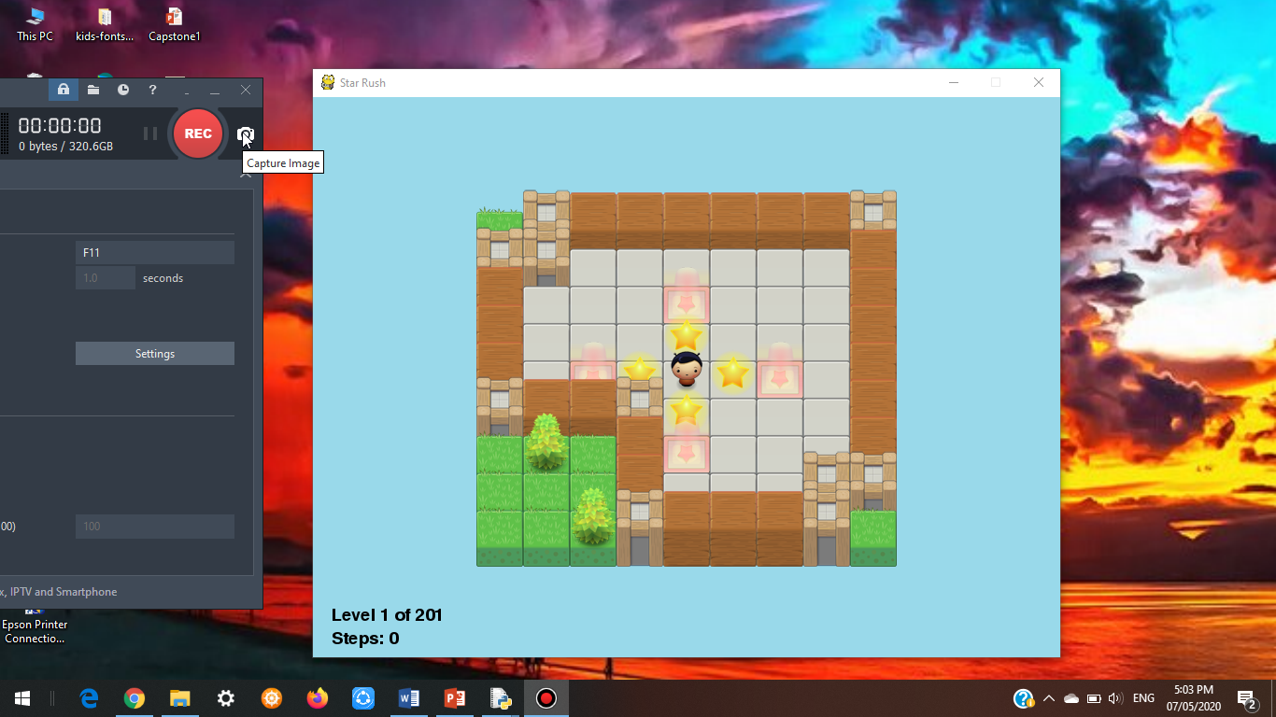
Gameplay System:
If you feel like going back again to the previous level press “B”
If you want to reset the level press “backspace”

Slide 9
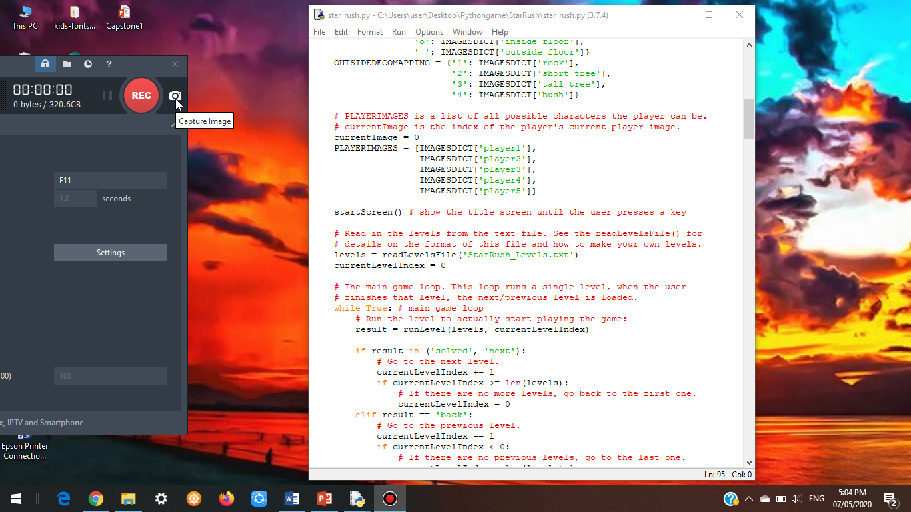
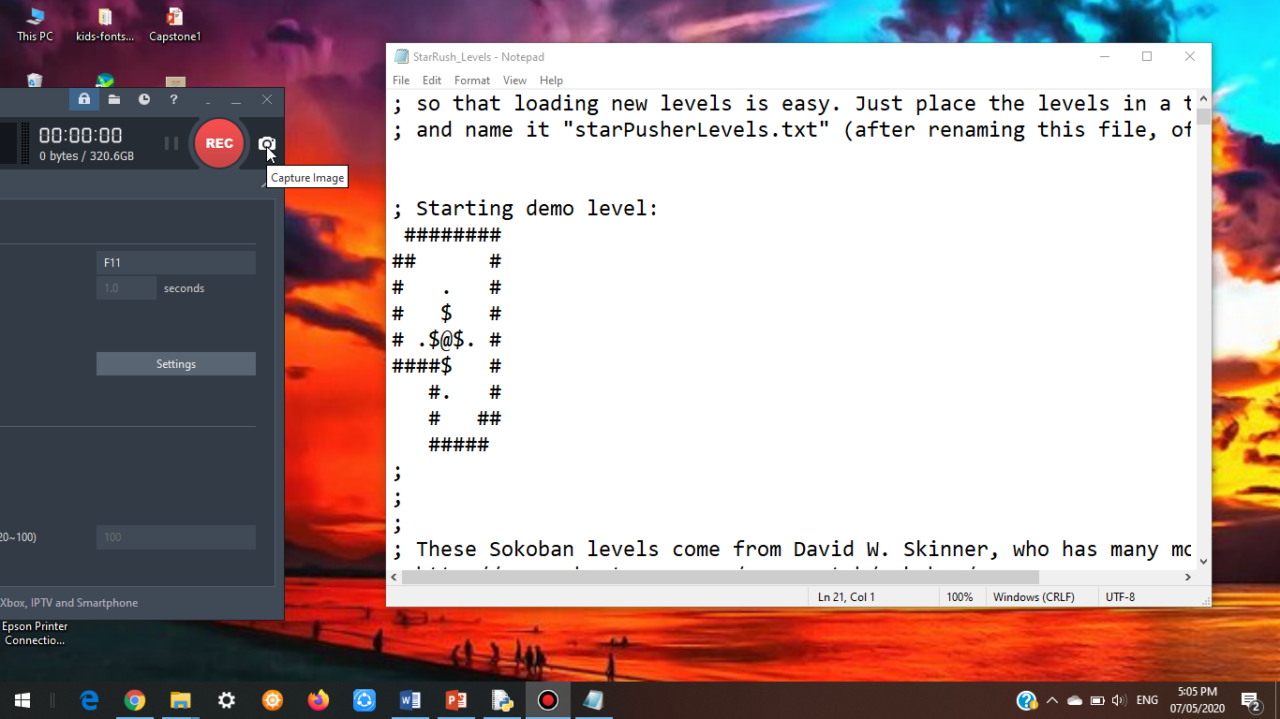
Gameplay System:
This is what the map looks like in character mode where every character gives function to a certain image like:
@ = player’s character
$ = star
. = base
# = wall
The levels in our game are imported from our StarRush_Levels.txt file for a more easier way of programming and less ambiguous code

